Slide 1


GOTHIC2 Clinical Trial
Information for in-patient services
NIHR EME Funded (NIHR131157)
Sponsor - University of Liverpool
IRAS ID - 1008055
Notes:
NIHR EME Project: NIHR131157
GOTHIC2 IRAS ID: 1008055

Slide 2

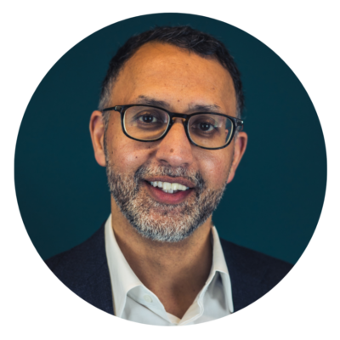
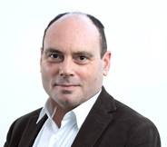
Key Contacts
Julie Perry, Trial Manager: gothic2@liverpool.ac.uk
Dr Inti Qurashi, Chief Investigator
Professor James MacCabe, Co-Chief Investigator
Notes:
NIHR EME Project: NIHR131157
GOTHIC2 IRAS ID: 1008055

Slide 3








GOTHIC2 Summary
GOTHIC2 is a clinical trial taking place across multiple NHS Trusts in England. The study has all the necessary ethical and regulatory approvals including Trust R&D approvals
GOTHIC2 aims to find effective treatment(s) for clozapine-induced hypersalivation (CIH) without adding to the overall side-effect burden.
Notes:
NIHR EME Project: NIHR131157
GOTHIC2 IRAS ID: 1008055

Slide 4
Why do we need this trial?
This trial is important because:
Whilst hyoscine is commonly used for CIH, we do not know if it is effective in reducing CIH. Clinicians are also prescribing other medications for CIH without good evidence of effectiveness.
There is some evidence that a novel medication for CIH, glycopyrrolate, may be effective for CIH without worsening cognitive (thinking) side-effects. Like hyoscine, glycopyrrolate is an anticholinergic medicine, but unlike hyoscine it does not enter the brain, so may have fewer cognitive (thinking) adverse effects.
Notes:
NIHR EME Project: NIHR131157
GOTHIC2 IRAS ID: 1008055

Slide 5

Why do we need this trial?
GOTHIC2 will explore:
Whether hyoscine and/or glycopyrrolate is/are more effective than placebo (‘dummy tablet’) in treating CIH
Whether glycopyrrolate has fewer cognitive (thinking) and other side effects than hyoscine.
Notes:
NIHR EME Project: NIHR131157
GOTHIC2 IRAS ID: 1008055

Slide 6

What will this trial achieve?
Information for prescribers to offer evidence-based treatments for CIH - that is treatments proven to be effective and well tolerated.
Help patients make an informed choice about which medication is more suitable for them for CIH based on their overall side-effect profile.
Notes:
NIHR EME Project: NIHR131157
GOTHIC2 IRAS ID: 1008055

Slide 7
Information for ward staff
One or more patients on this ward are taking part in the GOTHIC2 study. These patients are referred to as study participants.
Each participant has an equal chance of being allocated to one of the three study arms (placebo, hyoscine, glycopyrrolate).
The participant, their doctors, nurses and the research staff do not know which arm each participant is allocated to; that is, the study is blinded. This is important as it reduces bias when collecting study data.
Notes:
NIHR EME Project: NIHR131157
GOTHIC2 IRAS ID: 1008055

Slide 8

Information for ward staff
The study medication is supplied as capsules to look completely identical.
Study medication will be prescribed for each participant alongside
usual prescribed medication (this has been checked as part of the
eligibility process by a study medic).
Study medication will be prescribed by a study medic for up to 12 weeks.
Do not ask doctors/nurse prescribers on the ward/in the hospital to prescribe the study medication or make changes to it. Please contact a member of the study team.
Notes:
NIHR EME Project: NIHR131157
GOTHIC2 IRAS ID: 1008055

Slide 9
Do’s and Don’ts
NEVER administer study medication to anyone other than the patient whose name is on the label.
If you run out of study medication for a participant, contact your clinical trials/research pharmacy who will advise on any actions that are needed
NEVER open or crush the capsules to make it easier for the patient to swallow the medication as this will make the contents obvious and break the blind.
Notes:
NIHR EME Project: NIHR131157
GOTHIC2 IRAS ID: 1008055

Slide 10
Do’s and Don’ts
Patients can withdraw their consent to participate in the study at any point, even if they are detained under the Mental Health Act. Inform the local research assistant if this situation arises. DO NOT try to enforce study medication
Do not ask doctors on the ward/in the hospital to prescribe the study medication or make changes to it. The principal investigator at your Trust should be contacted.
Notes:
NIHR EME Project: NIHR131157
GOTHIC2 IRAS ID: 1008055

Slide 11
Study drug supply and monitoring
  Study medication must be prescribed by a study-approved prescriber who has the role of “prescribing trial treatment”
  Study medication will be supplied by the pharmacy clinical trials team and delivered by the trial research assistant (RA)
  The RA will hand over the study medication to nurse in charge/delegated nurse for medication and obtain signature for audit paperwork
  Study medication must be kept locked away and only administered to the participant it is labelled for.
Notes:
NIHR EME Project: NIHR131157
GOTHIC2 IRAS ID: 1008055

Slide 12
Study drug supply and monitoring
  The study medication label will look different to non-trial medication and will say it is a clinical trial medication
  Supplies will be provided by the Trust Pharmacy Clinical Trials or Research team (one bottle every four weeks for maximum 12 weeks)
  Any leftover IMP should be given to the RA who will in turn return to the Pharmacy Clinical Trials team for drug accountability.
Notes:
NIHR EME Project: NIHR131157
GOTHIC2 IRAS ID: 1008055

Slide 13
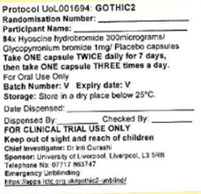
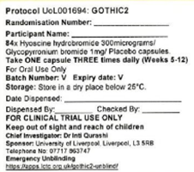
Study drug supply and monitoring
This is the label on the bottle of medication for the first supply (weeks 1 to 4)
This is the label on the bottle of medication for the second and third supply (weeks 5 to12)
Notes:
NIHR EME Project: NIHR131157
GOTHIC2 IRAS ID: 1008055

Slide 14

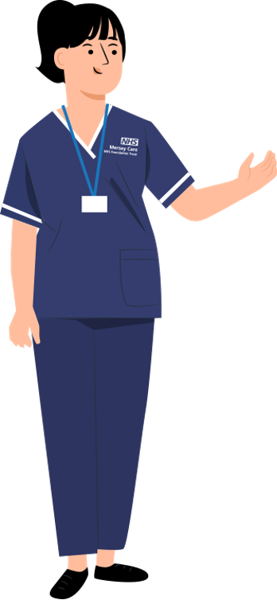

Study visits
Sept to Nov
The RA will provide a participant information leaflet and a comprehensive explanation of the trial to the patient who will then have at least 24 hours to consider participation.
Patients are reminded that participation is voluntary and they can withdraw participation at any point.
Study doctors will complete eligibility checks.
If they would like to participate, the RA will review the participant information leaflet with them to check understanding and complete informed consent.
Dec to Feb
Responsible Clinician’s will ask patients whether they would like information about the GOTHIC2 Clinical Trial. Participation is voluntary.
If the patient meets eligibility criteria and is on medication for clozapine induced hypersalivation, a 48 hour washout period will be organised.
1)

Slide 15

Study visits
Sept to Nov
The RA will schedule follow up visits to the ward during the 12 week trial:
Week 1, 2, 6: approx. 10 minute appointment
Week 4, 8: approx. 20 to 30 minute appointment
Week 12: approximately two hour appointment (can be split into two visits to reduce burden)
After the washout or if a washout is not required, the RA will visit the ward to complete the baseline assessment (approximately two hours and can be split into two visits to reduce burden).
At the week 12 follow up, the participant is unblinded and compensated £25 in vouchers. Alternative arrangements will be made for in-patients where vouchers are not permitted. Participants will return to routine care and ongoing treatment will be a local decision.
1)
The participant will then be randomised and compensated £25 in vouchers. Alternative arrangements will be made for in-patients where vouchers are not permitted. Trial medication will be delivered to the ward for the participant to begin treatment.
During follow up visits, participants will complete measures assessing drooling, side effects, symptoms of schizophrenia and a cognitive assessment. Only the baseline and week 12 follow up include the full set of measures.

Slide 16
Good clinical practice
GCP = “Internationally recognised ethical and scientific quality requirements which must be observed for designing, conducting, recording and reporting clinical trials that involve the participation of human subjects”
GCP ensures that participants are protected and trial results are credible
This trial must be conducted in accordance with GCP and the current approved protocol
All members of the trial research team have undertaken GCP training.
Notes:
NIHR EME Project: NIHR131157
GOTHIC2 IRAS ID: 1008055

Slide 17
Good clinical practice
Each ward that has a participant included will have a Ward Sister/Ward Manager/Modern Matron named on the paper Delegation Log, taking overall responsibility for staff on their shift
No protocol specific or GCP training is required, however they must receive a study overview, for example watching this video or a written summary provided by research staff.
Notes:
NIHR EME Project: NIHR131157
GOTHIC2 IRAS ID: 1008055

Slide 18
Good clinical practice
Core principles and purpose:
Ethical Protection: Protects the rights, safety, and well-being of trial participants, grounded in principles like informed consent, beneficence (maximising benefits, minimising harm), and justice (fair selection)
Who Must Comply? Pharmaceutical companies, universities and NHS hospitals, contract research organisations (CROs), charities and GP practices, and laboratories analysing trial samples.
Notes:
NIHR EME Project: NIHR131157
GOTHIC2 IRAS ID: 1008055

Slide 19
Good clinical practice
Key Aspects
ICH guidelines: Developed by the International Conference on Harmonisation (ICH) to create harmonised standards
Legal obligation: Compliance with GCP is a legal requirement, not just best practice. All trials of investigational medicinal products in the UK are legally required to comply with the ICH GCP E6(R3) Conditions and Principles.
Training: Researchers conducting trials are required to complete GCP training to ensure competence and adherence to standards.
Notes:
NIHR EME Project: NIHR131157
GOTHIC2 IRAS ID: 1008055

Slide 20
Good clinical practice
Why comply with GCP?
Makes good regulatory business sense
Facilitates registration approvals
Assures scientific ethical research
Credibility with health authorities and public
Protects human subjects
Notes:
NIHR EME Project: NIHR131157
GOTHIC2 IRAS ID: 1008055

Slide 21
Reminder
NEVER administer study medication to anyone other than the patient whose name is on the label
NEVER open or crush the capsules to make it easier for the patient to swallow the medication
If you run out of study medication for a participant, contact your clinical trials or research pharmacy.
DO NOT try to enforce study medication. Patients can withdraw their consent to participate in the study at any point, even if they are detained under the Mental Health Act
Do not ask doctors on the ward/in the hospital to prescribe the study medication or make changes to it. The principal investigator at your Trust should be contacted.
For GOTHIC2 queries please contact your R&D department.
Notes:
NIHR EME Project: NIHR131157
GOTHIC2 IRAS ID: 1008055

Slide 22

More information
If you would like any further general information about the GOTHIC2 study, please look at the study website:
gothic2@liverpool.ac.uk
The full study research plan (protocol) is available on the NIHR website: https://fundingawards.nihr.ac.uk/award/NIHR131157.
The local research assistant, study principal investigator and pharmacy will be able to help with any specific questions you have relating to the trial or patient under your care.
Notes:
NIHR EME Project: NIHR131157
GOTHIC2 IRAS ID: 1008055

Slide 23
Thank you
If you have any study queries please contact the Trial Manager: Julie Perry, gothic2@liverpool.ac.uk
Notes:
NIHR EME Project: NIHR131157
GOTHIC2 IRAS ID: 1008055

Slide 24
Local Site Key Contacts
Principal Investigator: [insert contact]
Clinical Trials/Research Pharmacist: [insert contact]
Research and Development: [insert contact]
Research Assistant/Clinical Research Practitioner/Research Nurse: [insert contact]
Notes:
NIHR EME Project: NIHR131157
GOTHIC2 IRAS ID: 1008055

